Slide 1
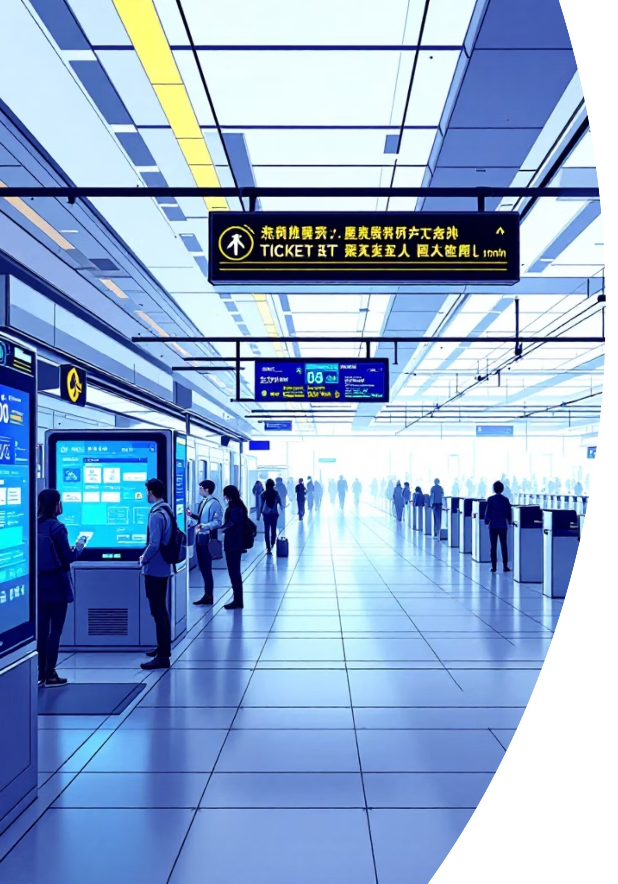
Linked List Implementation for Ticket Booking System
Ticket Class
package exp1;
import java.util.Scanner;
class Ticket{
String passanger;
int seatno;
Ticket(String P, int S)
{
this.passanger=P;
this.seatno=S;
}
}
This code defines a Ticket class with passenger name and seat number attributes, along with a constructor to initialize these fields.

Slide 2
Singly Linked List Node
class sll{
private sll head;
sll next;
Ticket ticket;
sll(Ticket t){
ticket = t;
next = null;
}
}
This code creates a sll (singly linked list) node class that contains a Ticket object and a reference to the next node in the list.

Slide 3
Adding and Removing Tickets
class linkedlist2{
sll cnode,head;
public void add_ticket(Ticket t)
{
sll newnode = new sll(t);
if(head == null)
{
head = newnode;
}
else {
sll cnode = head;
while(cnode.next!=null)
{
cnode = cnode.next;
}
cnode.next = newnode;
}
}
public void remove_ticket(int seatno)
{
if(head==null)System.out.println("list is empty");
else {
sll cnode = head;
if(cnode.ticket.seatno==seatno)
{
System.out.println("deleted "+ head.ticket.passanger);
head = head.next;
}
else {
while(cnode!=null&& cnode.next.ticket.seatno != seatno)
{
cnode = cnode.next;
}
if(cnode==null)
System.out.println("seat number not found");
else {
System.out.println("deleted "+cnode.ticket.passanger);
cnode.next = cnode.next.next;
}
}
}
}
}
This code implements add_ticket and remove_ticket methods for the linked list. The add method appends a new ticket to the end of the list, while the remove method searches for and deletes a ticket by seat number.

Slide 4
Displaying and Querying Tickets
public void displayticktes()
{
if(head == null)
{
System.out.println("No tickets booked ");
}
else {
sll cnode = head;
System.out.println("booked tickets: ");
while(cnode!=null)
{
System.out.println(cnode.ticket.seatno+"-->"+cnode.ticket.passanger);
cnode = cnode.next;
}
}
}
public boolean isbooked(int seat)
{
sll cnode = head;
while(cnode!=null)
{
if(cnode.ticket.seatno==seat)
{
return true;
}
else
{
cnode = cnode.next;
}
}
return false;
}
public int count()
{
int count =0;
cnode = head;
while(cnode!=null)
{
cnode = cnode.next;
count++;
}
return count;
}
This code provides three utility methods: displayticktes prints all booked tickets, isbooked checks if a seat is already reserved, and count returns the total number of booked tickets.

Slide 5
Ticket Stack Implementation
class ticketstk{ private Ticket[] stack; private int top; private int capacity; ticketstk(int no_ticktes) { capacity = no_ticktes; stack = new Ticket[capacity]; top = -1; } boolean isEmpty() { return top==-1; } boolean isFull(){ return top==capacity-1; } public void push(Ticket t) { if(!isFull()) stack[++top]=t; } public Ticket pop() { if(!isEmpty()) return stack[top--]; else return null; } public Ticket peek() { return stack[top]; } void display() { for(int i = 0;i
This code implements a ticketstk (stack) class that stores tickets in an array with push, pop, peek, and display operations. The stack is used to track recently booked tickets for quick cancellation.

Slide 6
Main Method and Menu
public class rough {
public static void main(String[] args) {
Scanner sc = new Scanner(System.in);
int totalseats = 40;
linkedlist2 llobj = new linkedlist2();
ticketstk stackobj = new ticketstk(totalseats);
boolean exit = true;
while (exit) {
System.out.println("\n1. Book Ticket");
System.out.println("2. Cancel Last Ticket");
System.out.println("3. Cancel by Seat Number");
System.out.println("4. View Booked Tickets");
System.out.println("5. View Available Seats");
System.out.println("6. Exit");
System.out.print("Choose an option: ");
int choice = sc.nextInt();
switch(choice) {
case 1:
System.out.println("Enter the name ");
String name = sc.next();
System.out.println("Enter the seat u want to book ");
int seat = sc.nextInt();
if(seat <1|| seat>40)
{
System.out.println("Invalid Choice!");
}
else if(llobj.isbooked(seat))
{
System.out.println("Seat already book");
}
else {
Ticket t = new Ticket(name,seat);
llobj.add_ticket(t);
System.out.println("Ticket booked suyccesfully ..... : )");
}
break;
case 2:
Ticket t = stackobj.pop();
if(t!=null)
System.out.println(t.seatno+"-->"+t.passanger);
else
System.out.println("no ticket booked at las");
break;
case 3:
System.out.println("Enter the seat u want to cancel");
int canseat = sc.nextInt();
llobj.remove_ticket(canseat);
break;
case 4:
llobj.displayticktes();
break;
case 5:
System.out.println("Available seats are "+(totalseats-llobj.count()));
break;
case 6:
exit = false;
break;
}
}
System.out.println("Thank you .... : )");
}
}
This code contains the main method that creates the ticket booking system interface. It presents a menu with options to book tickets, cancel the last ticket, cancel by seat number, view booked tickets, view available seats, or exit the program.

Slide 7

Thank You
thank you

